Slide 1
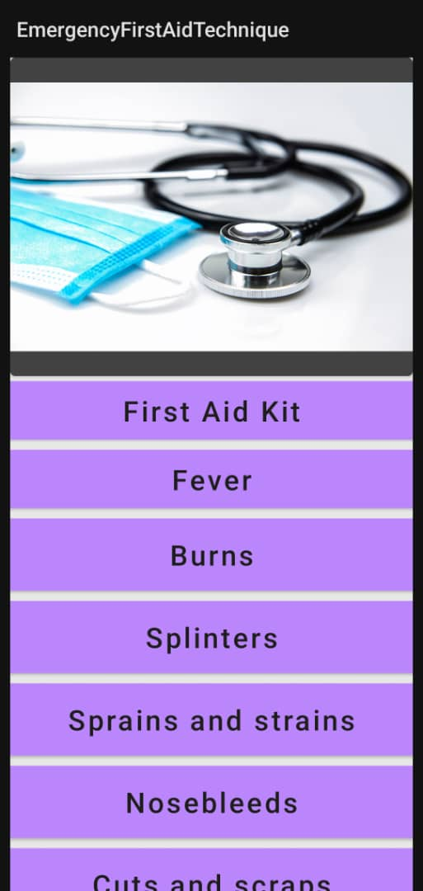
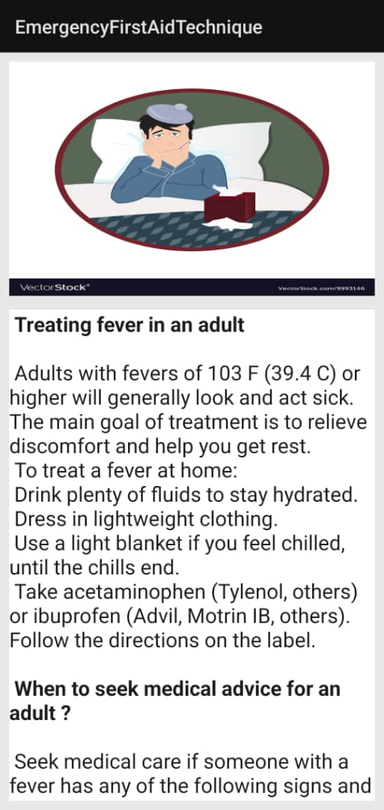
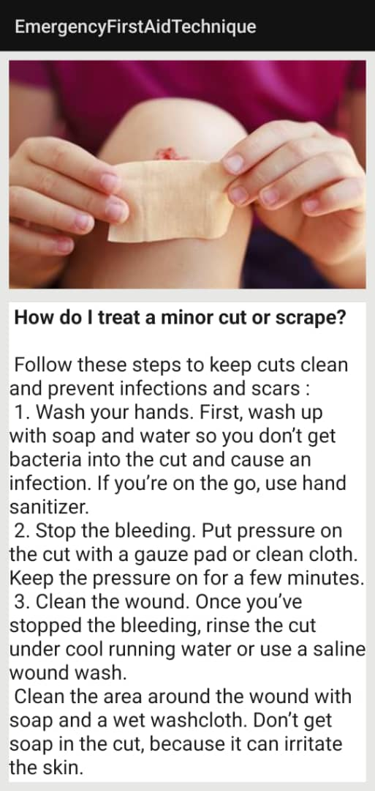
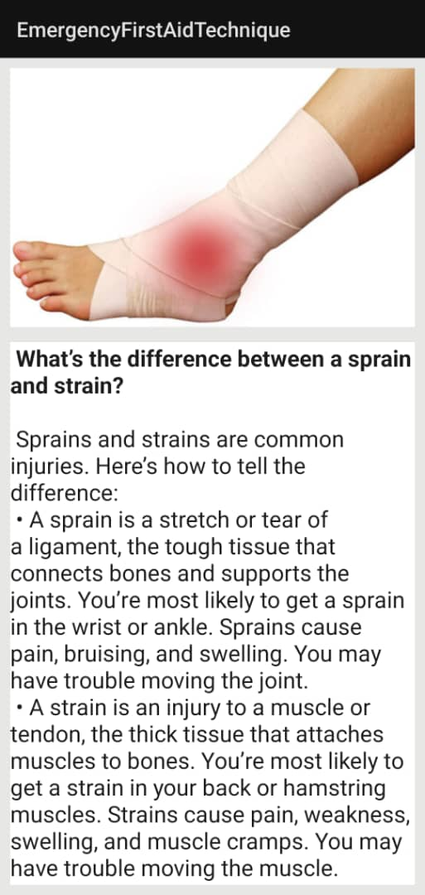
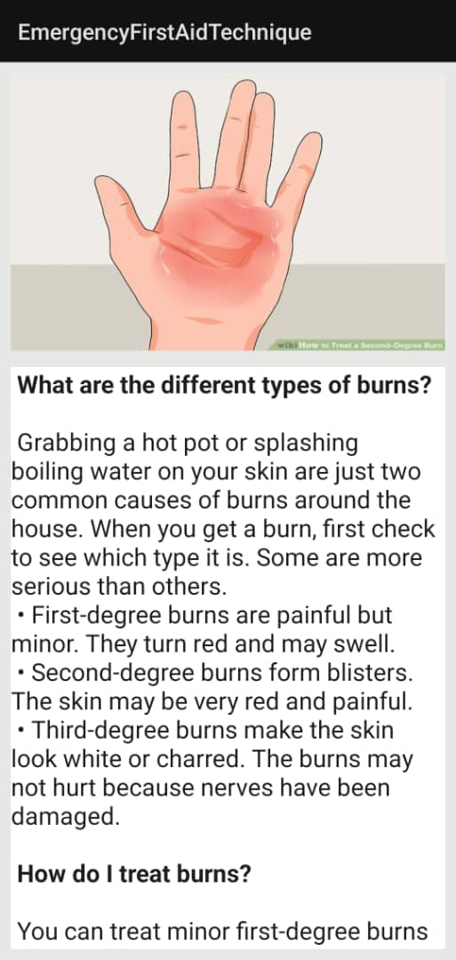
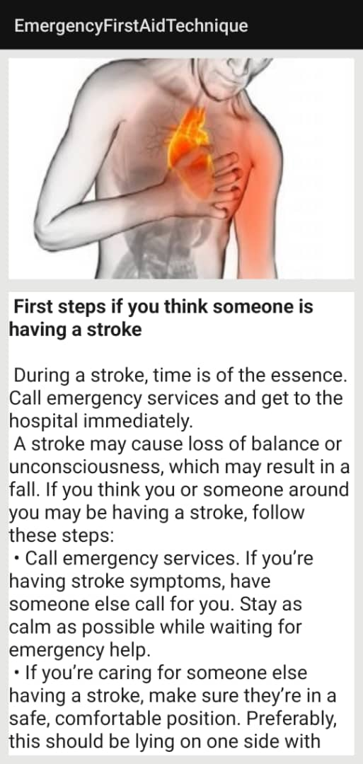
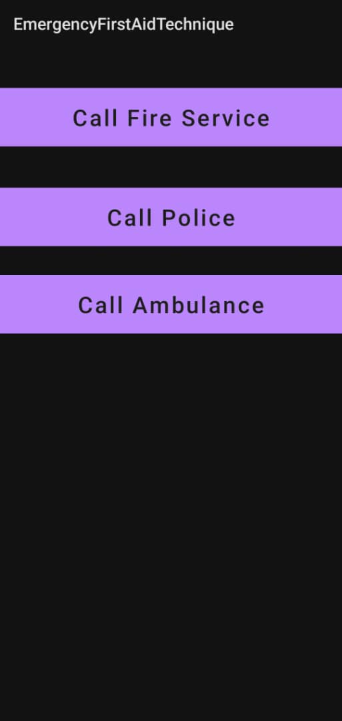

To address the aforementioned concerns, the researchers of the study proposed a First Aid Mobile Application, which aims to provide users with a source of information about how to perform first aid. The application is available for download and use in emergency situations. The user just has to input the injury or illnesses that occur unexpectedly, and the application will provide them the step-by-step process in administering first aid. The software will aid in the response to emergency situations and in saving of lives.
To address the aforementioned concerns, the researchers of the study proposed a First Aid Mobile Application, which aims to provide users with a source of information about how to perform first aid. The application is available for download and use in emergency situations. The user just has to input the injury or illnesses that occur unexpectedly, and the application will provide them the step-by-step process in administering first aid. The software will aid in the response to emergency situations and in saving of lives.
MOBILE APPLICATION:
FIRST AID AND EMERGENCY
Name: Eduakoh Michael Junior Index Number: 9403819
Supervisor: Dr. Eric Osei
Kwame Nkrumah University of Science and Technology (KNUST), Ghana
College of Science, Computer Science Department
Introduction
Program architecture
In an emergency, we might only have a few seconds to save a life. Is there anything we can do in an emergency to wait for help? Because we might only be able to rely on ourselves, we should act. First aid is the immediate care provided to an accident or illness victim before emergency medical assistance arrives. In various cases, including heart attacks where someone's breathing or heartbeat has stopped, cardiopulmonary resuscitation (CPR) is a lifesaving procedure or strategy. It is a technique that combines chest compressions and rescue breathing to keep the blood flowing to the brain while the heart is not beating.
Imagine if one day we discover our friend unconscious and on the floor. We run to contact the ambulance without knowing how long he has been there. That person is helpless while the ambulance is in route, and we are unable to assist him. Wouldn't you wish to have the abilities required to assist in saving him? Learning CPR is essential because it may be the difference between life and death. Additionally, sling injuries are the most common among teenagers and high school students. When one of our pals breaks an arm outside, the first thing we need to do is get him to support the arm with his hand. The lower end of the bandage should then be raised over the hand and forearm and tied in the hollow above the collarbone. After that, tuck the point in or twist it close to the elbow. In our daily lives, having first aid knowledge and skills is really vital.
user
Opens app
Call Emergency number
First Aid
Select the required first aid technique
Learn to administer the first aid
Interface of Program
Aims and Objectives
The interface of the program is quite simple and easy to use with a brief description of how to apply the First Aid.
Aim of the Project : The project's main aim is to create a first aid mobile application that is packed with knowledge about how to administer first aid in various emergency scenarios.
Goal of the Project
The initiative specifically attempts to accomplish the following goals :
1. To create an application that instructs the user in first aid utilizing that application.
2. The application will include first aid procedures for various illnesses and injuries.
3. To give users a means of communication with emergency hotlines following the administration of first aid.
The software is precise and trustworthy. The Development tools used are Java and android studio.
Functional requirements
In software engineering, a functional requirement defines a function of a software system or its component. A function is described as a set of inputs, the behaviour, and outputs (see also software).
Functional requirements may be calculations, technical details, data manipulation and processing, and other specific functionality that define what a system is supposed to accomplish. Behavioural requirements describing all the cases where the system uses the functional requirements are captured in use cases.
1. Android Phone; To perform and display the functionality of the project.
2. Android studio; To create, design, test, debug and run the android project.
3. Mouse; To navigate through the emulator
----------------------------------------------------------------------------------------------------------------------------------------------------------
* Basic system requirements for Android Studio Microsoft, Windows, Mac, Linux.
* Operating System Version Microsoft Windows 7/8/10 (32- or 64-bit).
* The Android Emulator only supports 64-bit Windows Mac OS X 10.10 (Yosemite) or higher, only up to 10.14 (macOS Mojave)
* GNOME or KDE desktop Tested on Linux based on Debian (4.19.67-2 rodete2).
* Random Access Memory (RAM) 4 GB RAM minimum; 8 GB RAM recommended.
* Free digital storage 2 GB of available digital storage minimum, 4 GB Recommended (500 MB for IDE + 1.5 GB for Android SDK and emulator system image).
* Minimum required- JDK version Java Development Kit 8
* Minimum screen resolution 1280 x 800
-----------------------------------------------------------------
4. Professional Medical Respondents. The application will help them in their work given that the patient was already given first aid; there is a high chance of saving the patient.
Contextual review
The proposed project is a mobile-based application designed to provide informative resources on first aid. The core modules of the system are the following:
Offline-Based Resources – users can use the application without an internet connection. These offline resources are very important in case of an emergency since the users can access the app without connecting to the internet.
Emergency Contact Information – users can access the contact information of hospitals, rescue team, and other emergency contact information in the app.
.

